Slide 1
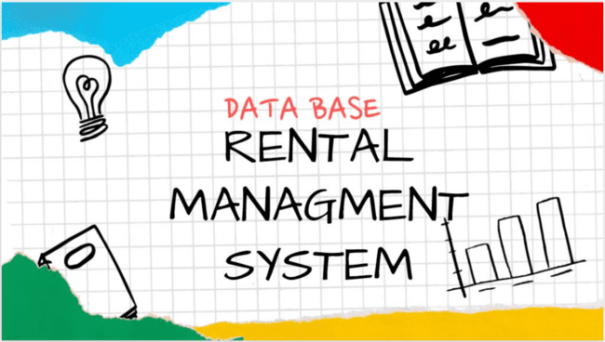

Slide 2

PROBLEM STATMENT
Managing rental properties using manual methods or basic file systems is inefficient, time-consuming, and prone to errors.
Users often rely on brokers to find suitable houses, which can lead to additional costs, delays, and lack of transparency.

Slide 3
⏱️ Time-consuming process
Searching for houses manually takes too long
No quick filtering or searching system
🧍 Broker-related issues
Extra costs (commission fees)
Lack of trust or transparency
🔍 Limited accessibility
Difficult to find specific properties quickly
No structured search system
📂 Poor data management
Data stored using manual file handling
Hard to update or maintain
🔁 Data inconsistency
Duplicate or outdated information
No centralized database

Slide 4
SOLUTIONS
Develop a database-driven real estate rental system
Use MySQL to manage structured and related data
Use MongoDB for flexible document-based data storage
Store and manage users, properties, locations, and contact information efficiently
Enable easy data retrieval using queries and filters
Ensure data integrity using primary and foreign key relationships

Slide 5
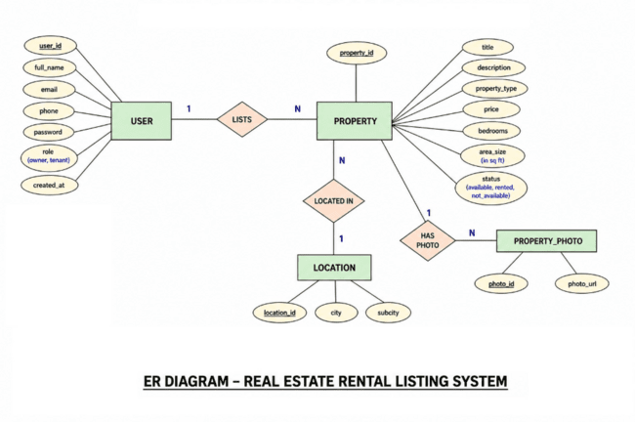
Entities:
User
Property
Location
Property Photo
System Design

Slide 6
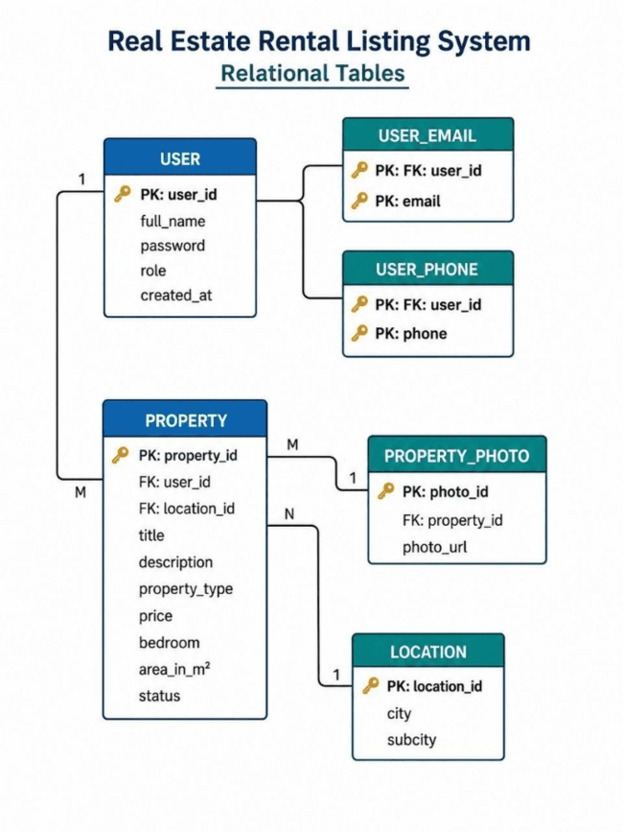
Database Implementation
Tables were created to store system data
Main tables: User, Property, Location, User Email, User .
Relationships defined using primary and foreign keys
Data integrity maintained through constraints and normalization.
Implemented using MySQL and MongoDB

Slide 7
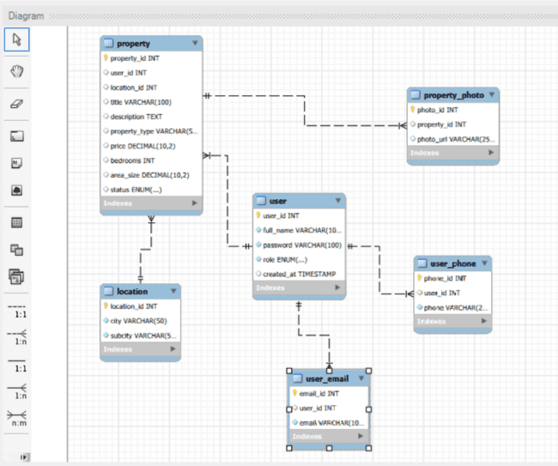
MYSQL
IMPLEMENTATION
Enhanced ER diagram from MYSQL using reverse engineering

Slide 8
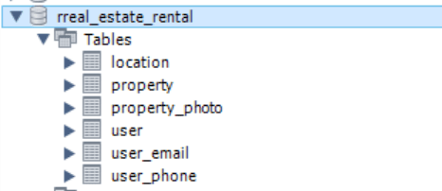
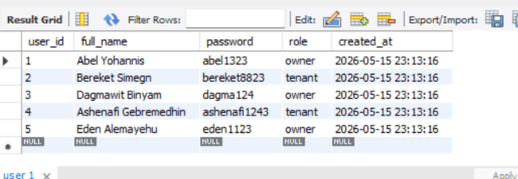
Sample Data
Sample records were inserted into the database
Data includes users, properties, and locations
Contact information (emails and phone numbers) added
Demonstrates one-to-many relationships
Used to test system functionality

Slide 9
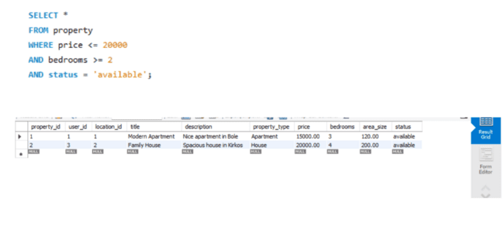
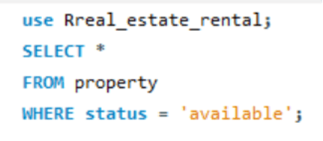
Query Execution
And Testing
MYSQL queries were used to retrieve data.
Filters applied for searching properties .
Queries return accurate and meaningful results .
Data insertion tested successfully.

Slide 10
{
"title": "Modern Apartment",
"price": 15000,
"location": {
"city": "Addis Ababa",
"subcity": "Bole"
},
"owner": {
"name": "Abel Yohannis"
}
}
MONGO DB IMPLEMENTATION
Used MongoDB for NoSQL implementation.
Data stored as collections and documents .
Flexible structure using JSON-like format.
Related data stored in a single document .
Supports scalable and flexible data storage.

Slide 11
ERRORS
Foreign key constraint errors during insertion .
Issues with JOIN queries initially .
Duplicate data (especially emails) caused errors .
Syntax errors in SQL statements .
Managing relationships between multiple tables.
Errors were resolved through debugging and testing.
Technologies Used
Tool | Purpose
MySQL Workbench | Relational database implementation
MongoDB Compass | NoSQL document database
draw.io | ER diagram creation
GitHub | Version control & collaboration
Google Docs | Report writing & formatting

Slide 12
CONCLUSION
In conclusion, this project allowed us to solve real-world data management problems while gaining practical experience in database design and implementation. It was also a valuable teamwork journey that strengthened both our technical and collaborative skills.

Slide 13
THANK YOU
PREPARED BY
1)ASHENAFI GEBREMEDHIN
2)ABEL YOHANNIS
3)BEREKETSIMEGN
4)DAGMAWIT BINIYAM
5)EDEN ALEMAYEHU
6)EDILAWIT LEGESE

